Slide 1
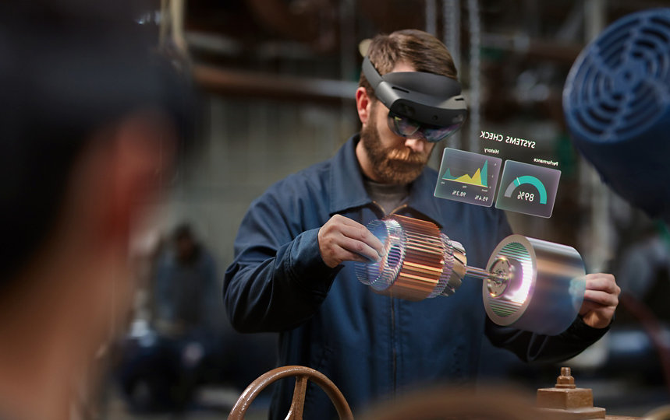
The Enhanced Digital Environment: Augmented Reality’s Effect On A Digital Society
Andrew Salermo

Slide 2
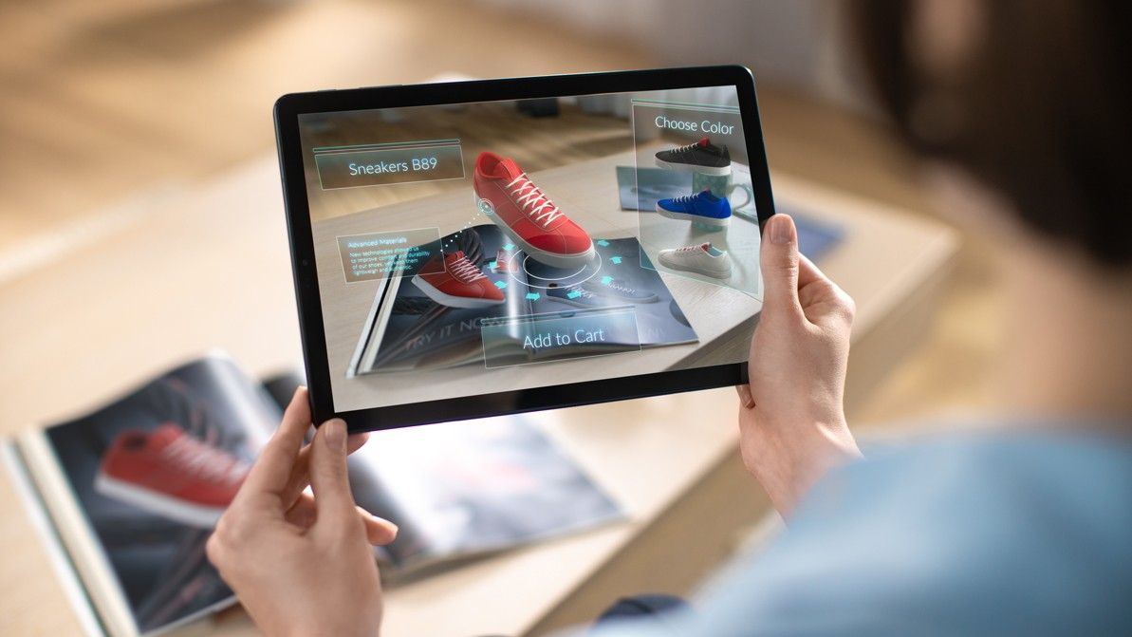
What is augmented Reality?
Augmented reality is defined as “the integration of digital information with the user's environment in real time... AR users experience a real-world environment with generated perceptual information overlaid on top of it” (Gillis, 2022).

Slide 3
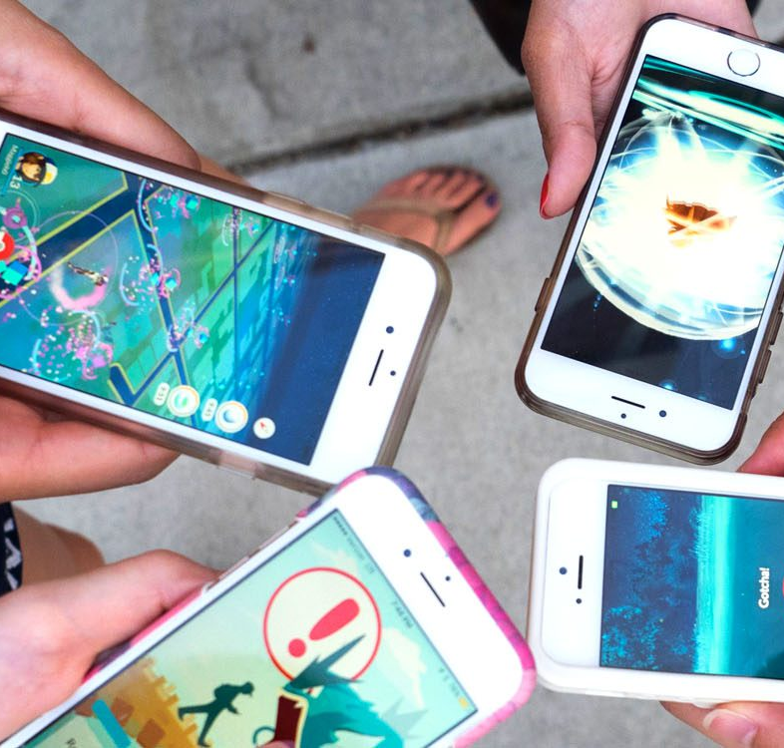
Change in the Development of Relationships

Slide 4
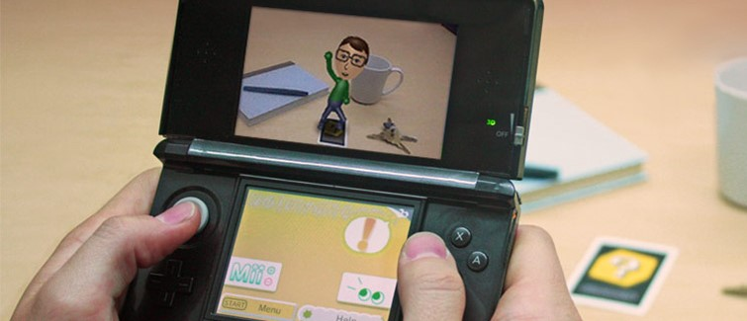
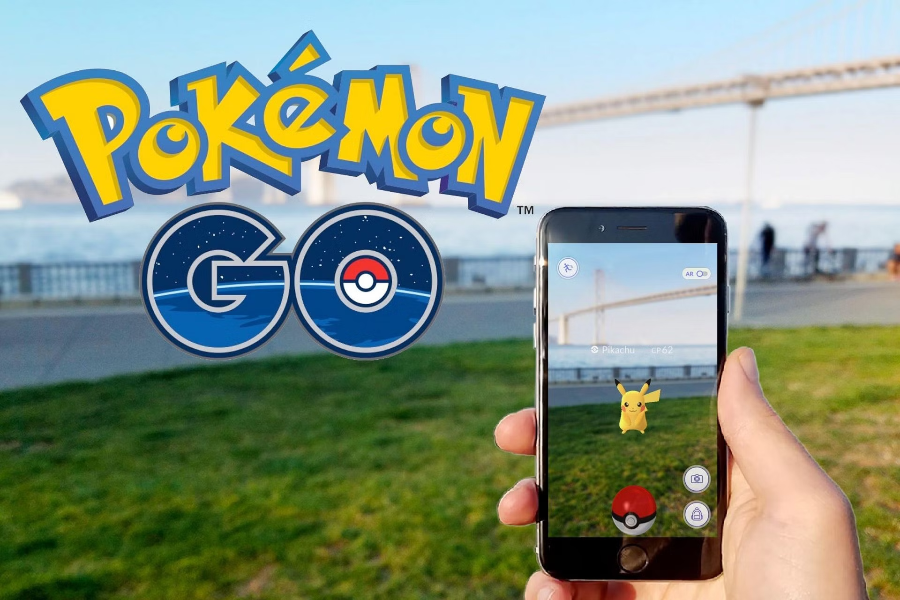
Mobile apps such as “Pokémon Go'' had the same effect as the 3DS. When I used to play Pokémon Go, people of all ages and from all over would come to parks and walk around. This built a sense of community, including relationships with people you might of never thought to meet. Augmented reality games like Pokémon Go are shown to, “bring people together by encouraging friends and family relationships, new friendships, outdoor activity, and reacquainting one’s environment” (Ku et al. 2021).
My earliest and fondest experience of using augmented reality, before I even knew what it was, can be traced back to when I was around 10. I got my first Nintendo handheld device, the 3DS. This device grew in popularity and became a trend that many kids around my age used. It was through this shared interest that I created relationships in my life that I still hold to this day.

Slide 5
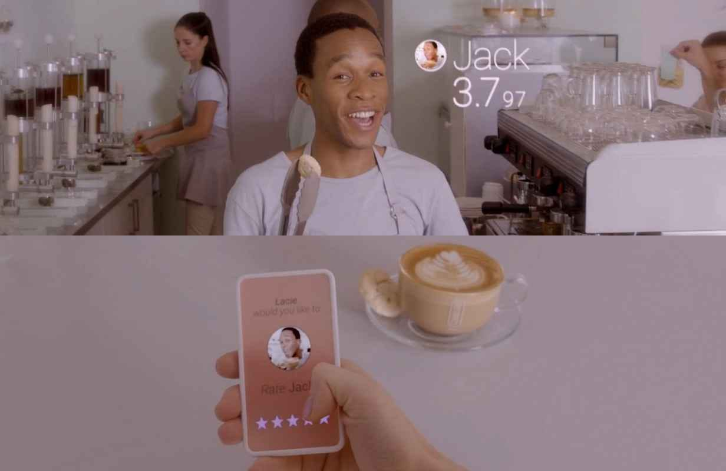
It is without a doubt that due to AR apps like Pokémon Go, AR has caused a disruptive impact on the way we develop relationships. Though the traffic of the app itself has notably died down, you still see people today, both young and old, getting
together and enjoying themselves through it.
One of my favorite predictions on how the use of augmented reality will affect relationships in the future has to do with an episode from a Netflix show called “Black Mirror”. In the episode titled Nosedive, society revolves around this new form of social media where people are rated on a scale of 5 stars. Even though this prediction is somewhat dark or negative I would not be surprised if something similar to it happens in the future due to the nature of people and social media.
*Spoiler Warning* Incase you haven’t watched the episode yet
The episode centers around this character who is consumed with getting a four-star rating, going to extreme lengths but that ultimately lead to her downfall and ruining a majority of her relationships.

Slide 6
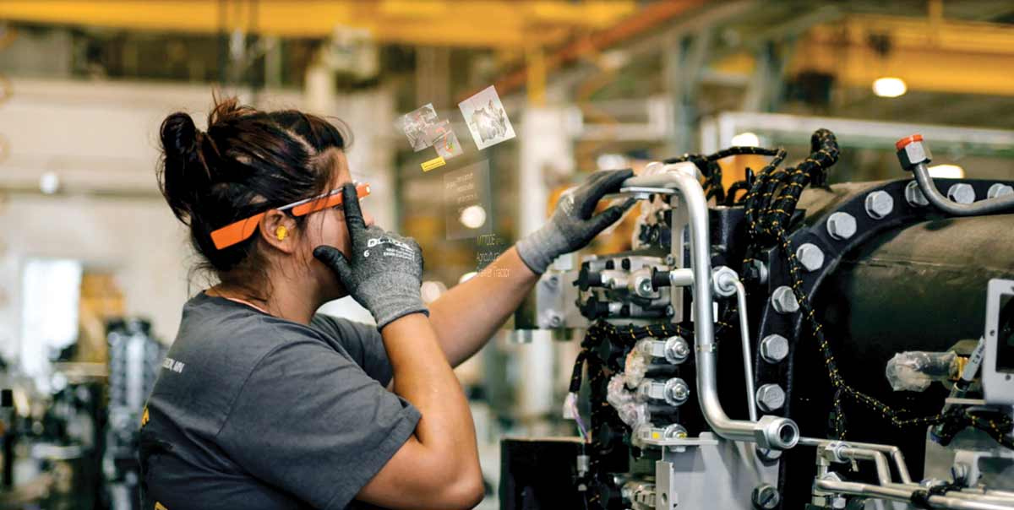
Change in Work

Slide 7
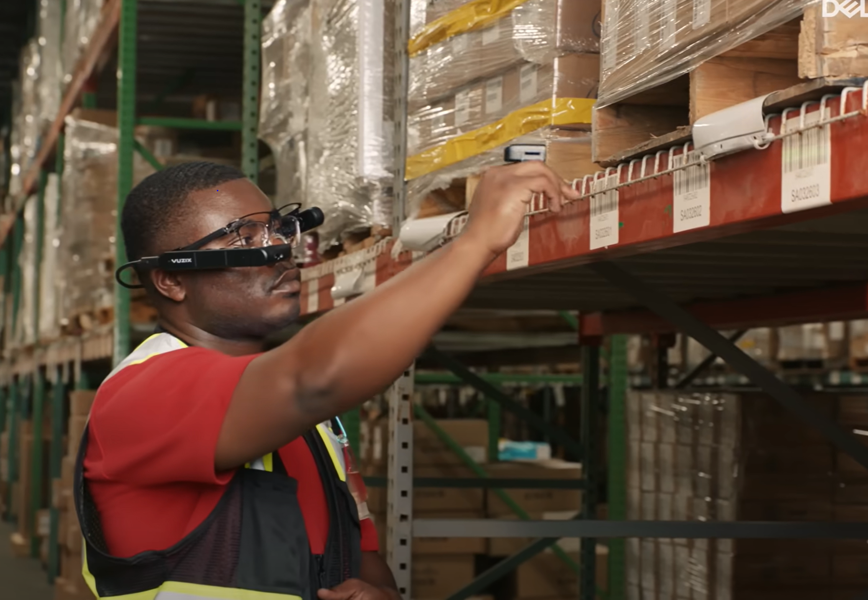
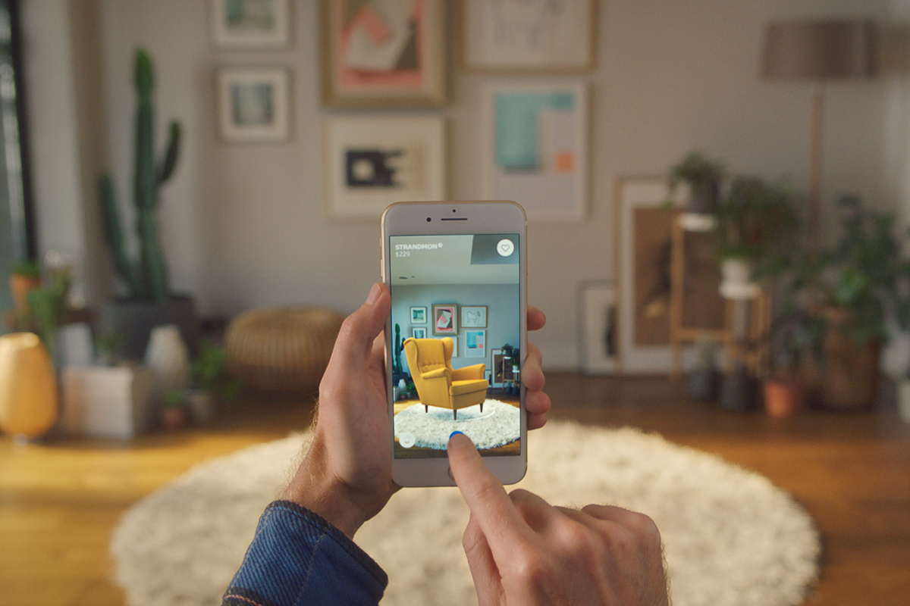
This technology is also used in businesses like the well-known
furniture store IKEA. With their app and augmented reality, customers can preview furniture in their own homes and even create room demos before making a purchase.
One example of how AR is used in the physical workplace setting, such as in a distribution center, is shown through Oculogx’s implementation of AR in combination with wearable displays. This technologies to be shown what to do throughout their workday. (Insider Business, 2022).
The results of implementing this technology show that it helps workers pick up to 40% faster and with 80% more accuracy.
This use of augmented reality is on track to becoming disruptive to various work situations around the world. The consistent positive results of this technology further enhance its disruptive potential. As more businesses and workplaces experience these favorable outcomes, they will incorporate it more.

Slide 8
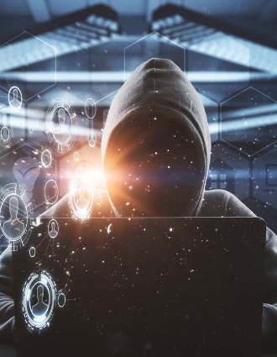
Change in Governing (privacy, security, regulation, politics)

Slide 9


privacy concerns also go hand in hand with security issues. As more people begin to use augmented reality technologies, their information and data can be at risk.
The sad reality is that These concerns of augmented reality aren’t yet widespread enough that new laws are created towards it. Given this, there doesn’t seem to be a large disruptive impact on governing in augmented reality
Contoso​
A prediction connected to privacy and data concerns is shown in chapter 11 of “Media & Society”:
”Consider the kinds of information an organization like Facebook could collect over the course of your life. … It can use that information not just to make decisions about what kind of person you are now but what life you are likely to lead in the future” (Carah & Louw, 2015).
This translates to the possible issues that would have to be addressed when giving augmented reality technologies our information and data. Laws, policies, and regulations evolve over time as new ideas and innovations appear in the world we live in which is why the same formula will take place for AR.
Security, safety, and privacy concerns continue to be issues, especially in areas such as AR when it comes to the internet and digital technology.
Safety concerns have already risen regarding the use of AR. An incident occurred where and individual has died using AR apps such as Pokémon Go, due to reckless driving.

Slide 10
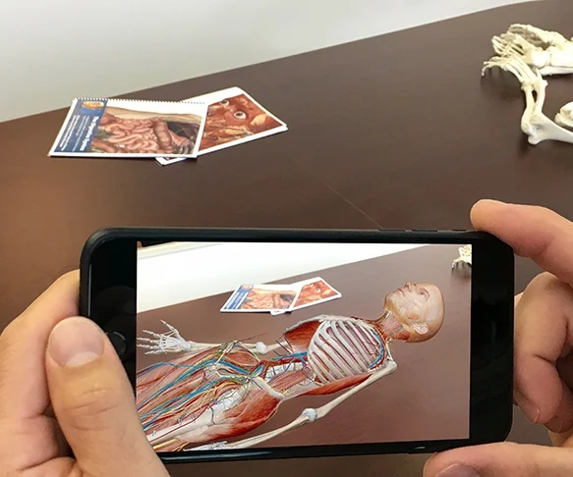
Change in social institution

Slide 11
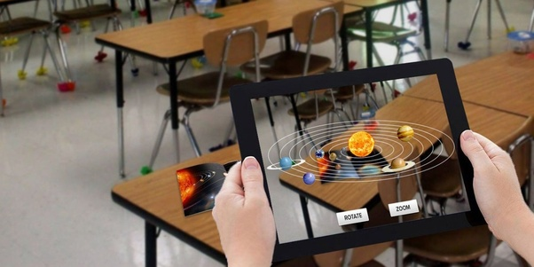
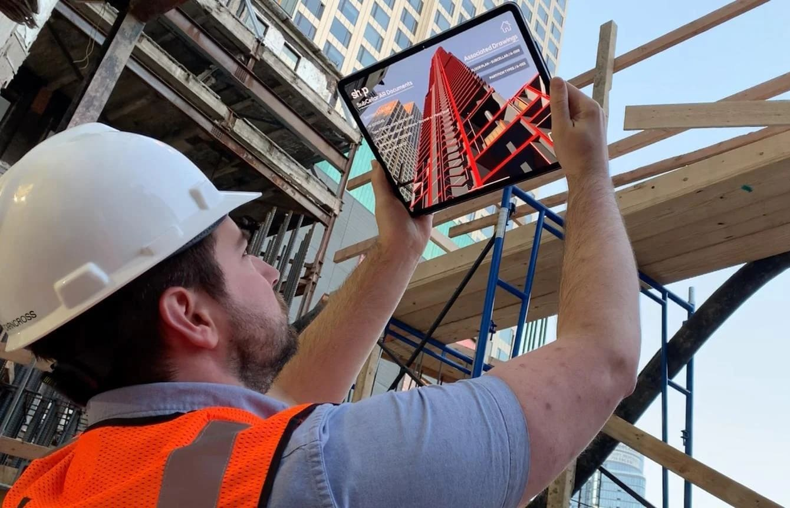
The uses of augmented reality in education could be considered one of the most important aspects of this technology. Most people are visual learners which adds to to this idea. Education can branch out to not
only schools but other sectors such as
Healthcare
Business
Engineering
Even though AR is becoming more common in social institutions, it seems to only have caused a small disruptive impact. The world is still adjusting to the implementation of augmented reality in educational and learning purposes but that will surely change in the future
I currently work as a substitute in elementary schools, but it doesn’t seem AR has made a significant impact in everyday education. Currently the idea of AR in education, specifically in schools, is niche but it has the potential to be used in all schools, regardless the subject.

Slide 12
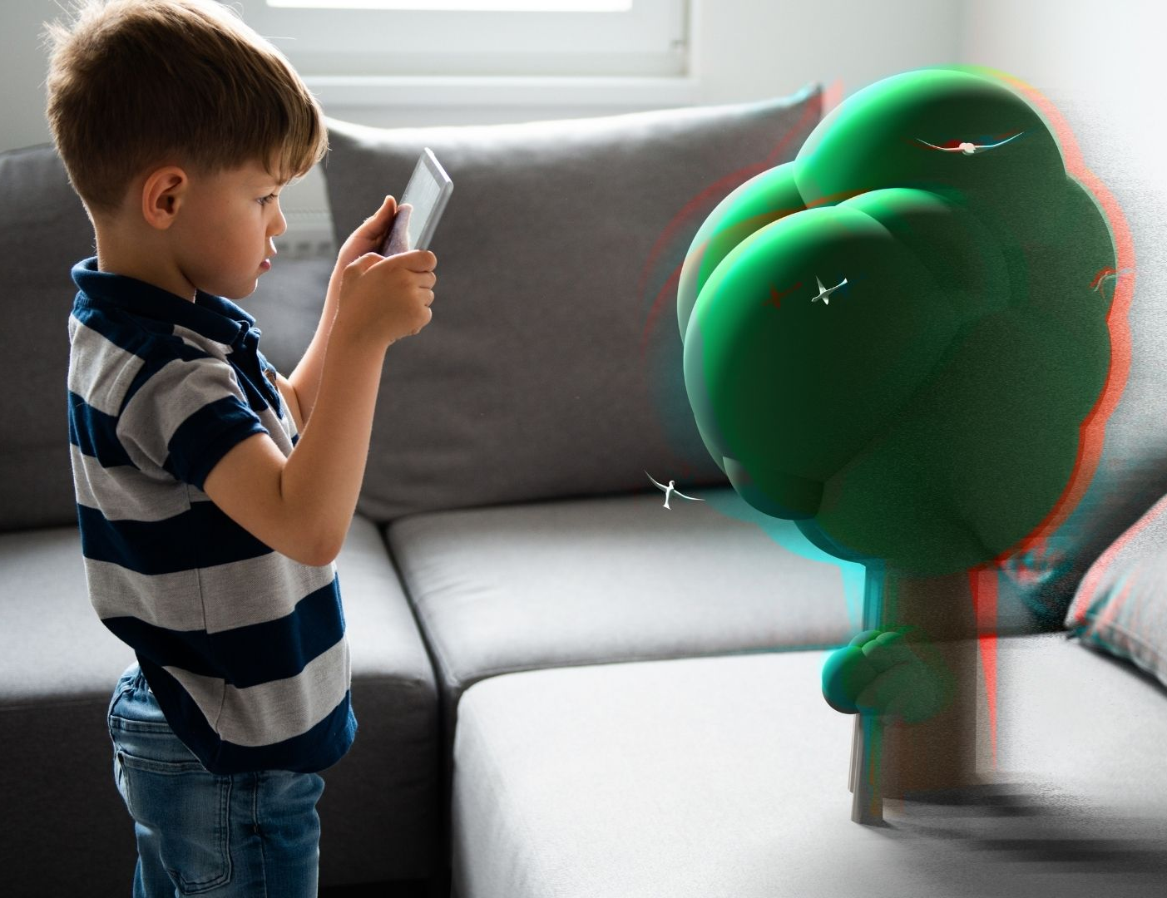
A prediction regarding AR in future education is that it may potentially affect those who grow up using it for learning. This is discussed in a news article about potential negatives of extended reality where Mary Chako stated,
“A meta-expansion of digital life and society will result in a corresponding reduction in personal control, with inevitable costs to our well-being”(Chayko, as cited in Anderson & Rainie, 2022).
If digital technologies such as augmented reality can have this effect on current users, then there should be more consideration on how it will affect future generations using augmented reality.

Slide 13
Conclusion
Augmented reality has come a long way due to its surge of popularity and improvements in the 21st century. It has had and will continue to have an impact and influence on the way relationships, work, governing, and social institutions function in our currently tech driven society.
AR is most notably disruptive in the relationship area as seen in the outcomes of its involvement with Pokémon Go. Though it wasn’t as disruptive in the other areas, it doesn’t mean it won’t be in the future.
To ensure the best possible future, we must take the predictions towards AR and work towards improving how we use it to create a safe and functioning digital technology that will impact the world in the best possible way.

